Slide 1
Chapter 8
SINGLE-BIT INSTRUCTIONS AND PROGRAMMING

Slide 2
Outlines
List the 8051 Assembly language instructions for bit manipulation
Code 8051 instructions for bit manipulation of ports
Explain which 8051 registers are bit-addressable
Describe which portions of the 8051 RAM are bit-addressable
Discuss bit manipulation of the carry flag
Describe the carry flag bit-related instructions of the 8051

Slide 3
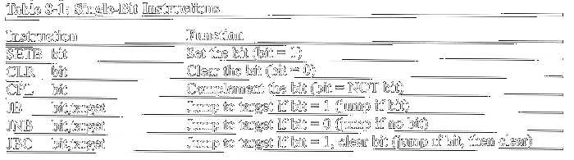
Single-bit instructions

Slide 4
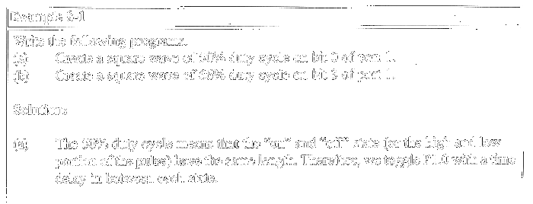
I/O ports and bit-addressability
The 8051 has four I/O ports, each of which is 8 bits

Slide 5
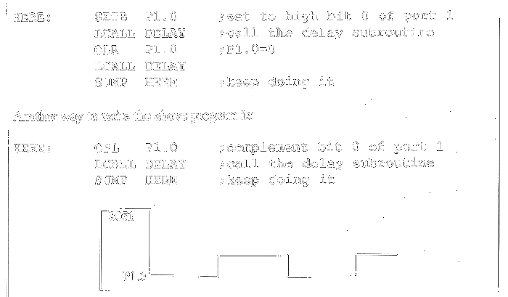

Slide 6
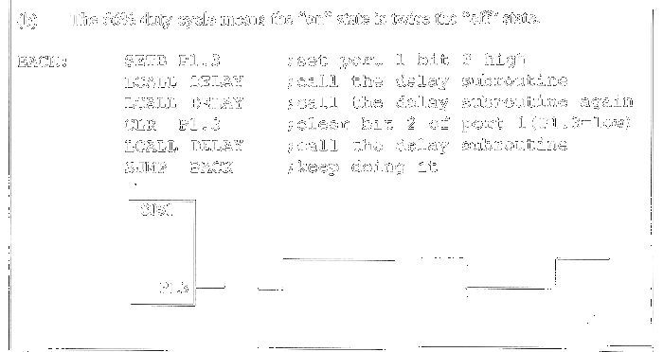

Slide 7
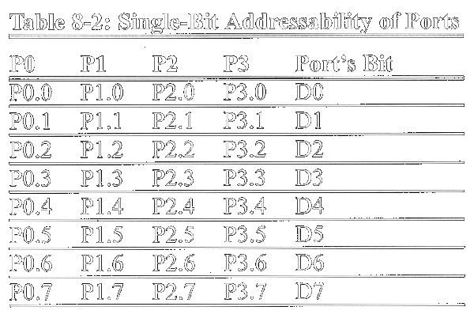

Slide 8
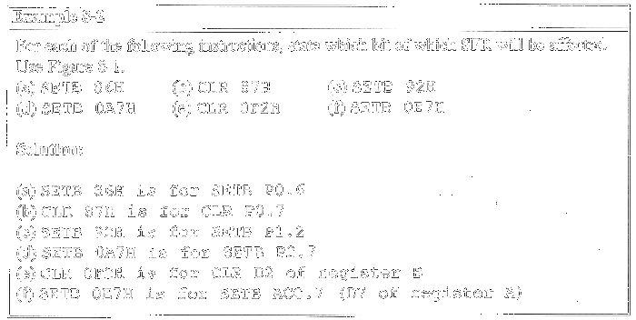

Slide 9
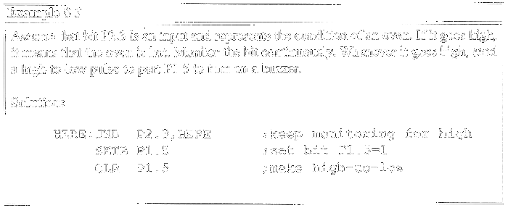
Checking an input bit
JNB (jump if no bit) ; JB (jump if bit = 1)

Slide 10
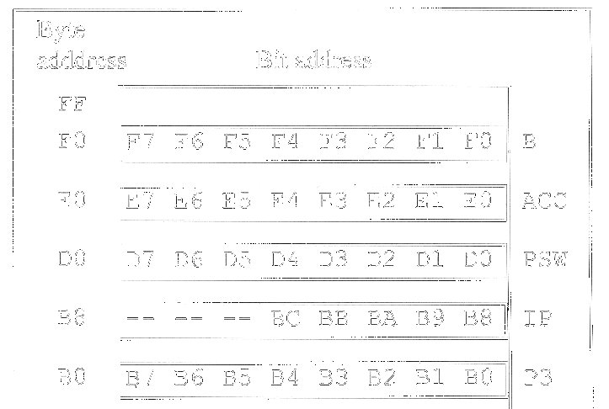
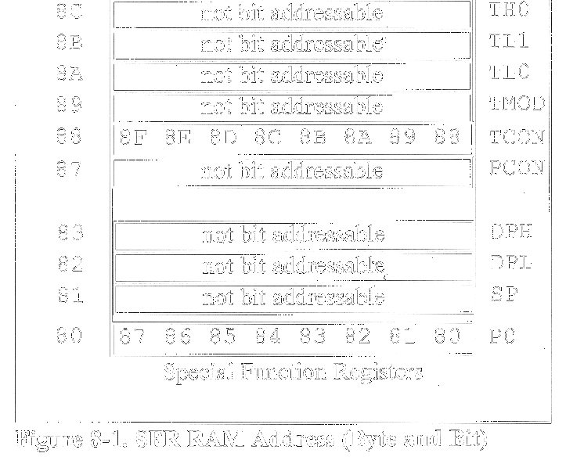
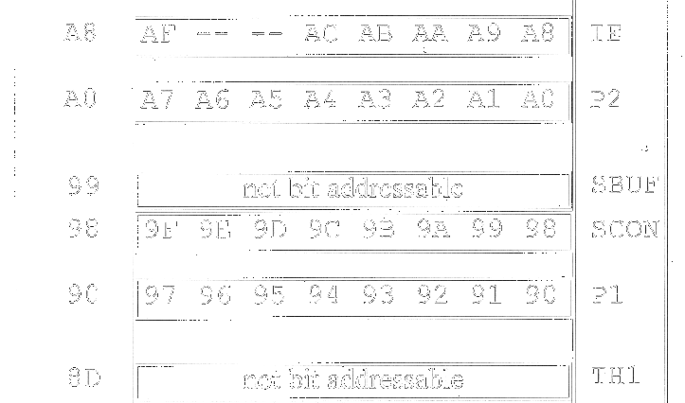
Registers and bit-addressability

Slide 11
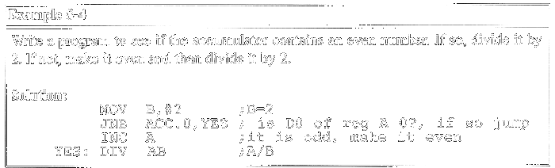
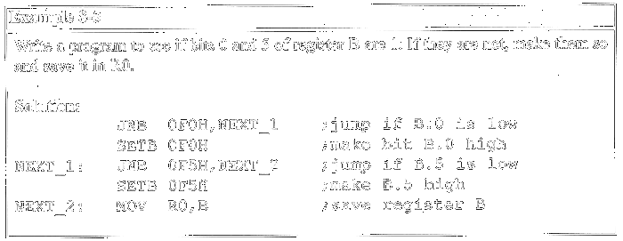

Slide 12
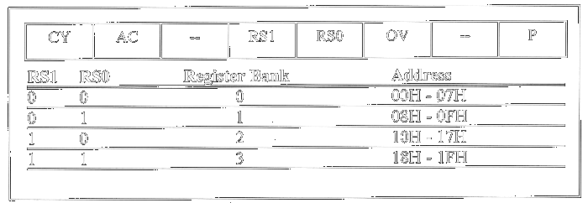
Figure 8-2. Bits of the PSW Register

Slide 13
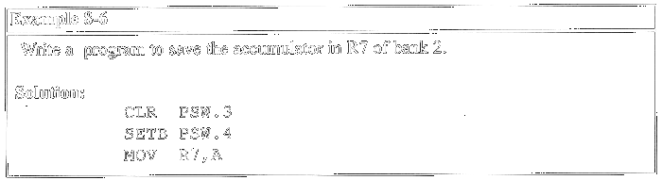
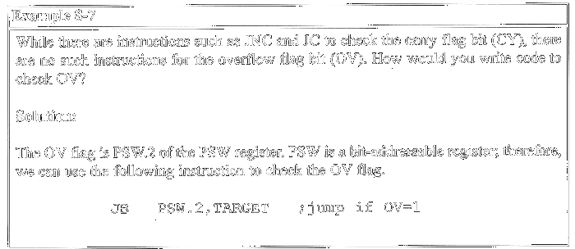

Slide 14
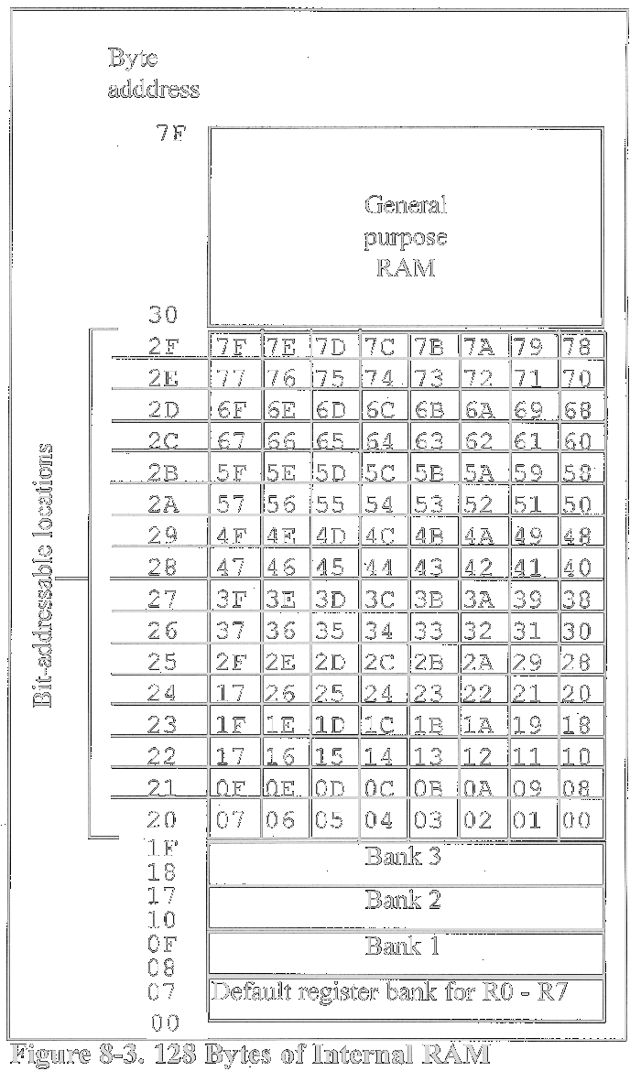
Bit-addressable RAM

Slide 15
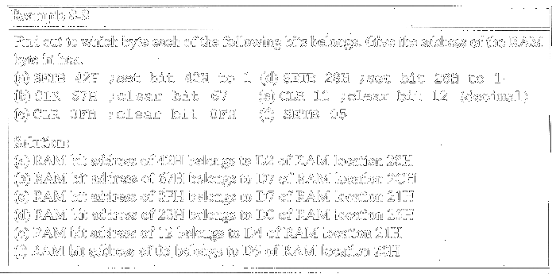

Slide 16
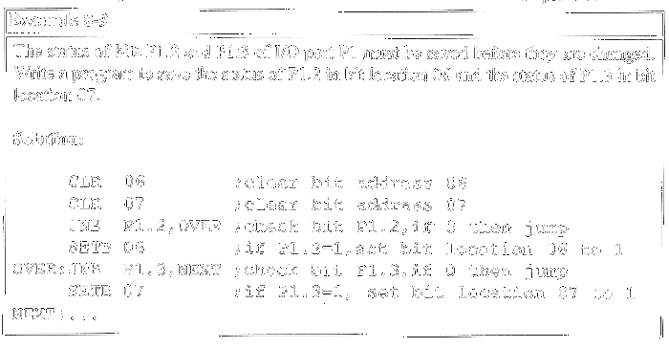

Slide 17
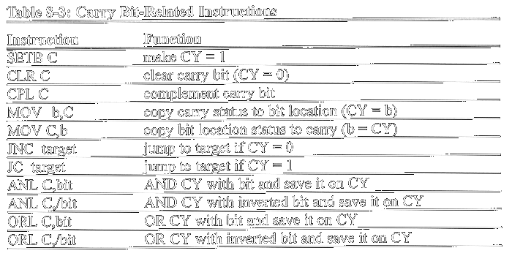
Single-bit operations with CY

Slide 18
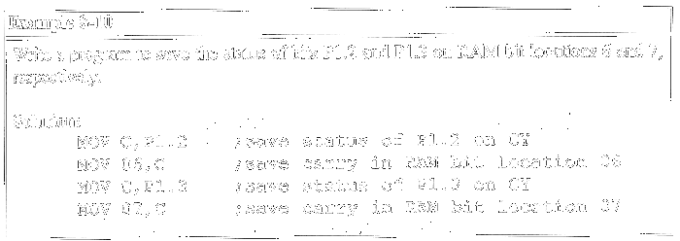

Slide 19
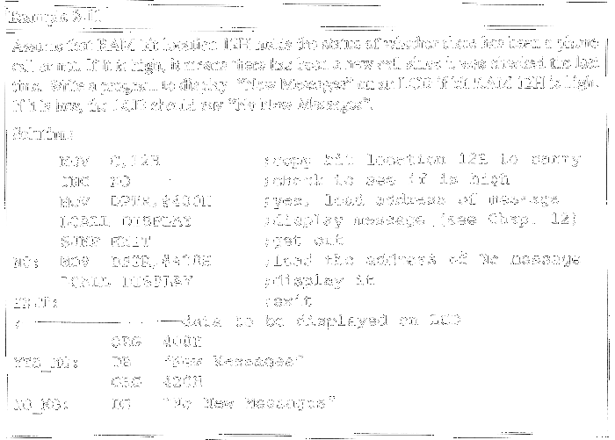

Slide 20
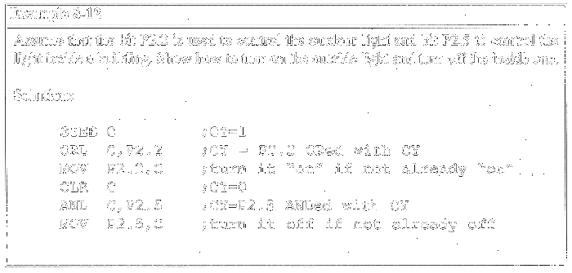

Slide 21
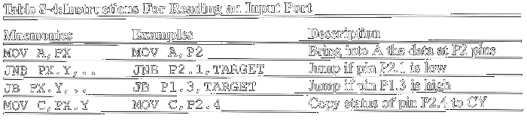
Instructions for reading input port
READING INPUT PINS VS. PORT LATCH
In Reading a port:
1.Read the status of the input pin
2.Read the internal latch of the output port

Slide 22
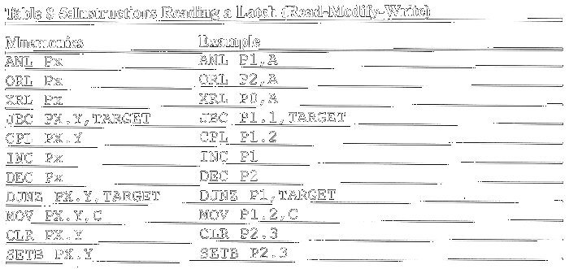
Reading latch for output port

